Slide 1
Snake Game Automation
By -
Rashmeet & Yuvraj

Slide 2




Concepts and Technologies used
Deep Q Learning
Convolutional Neural Networks

Slide 3
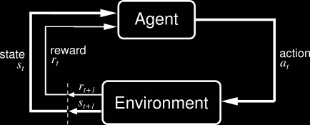
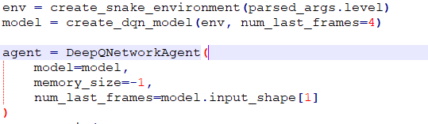
Reinforcement Learning
Snake Environment
States to agent
Snake Agent
Actions on states
Rewards

Slide 4
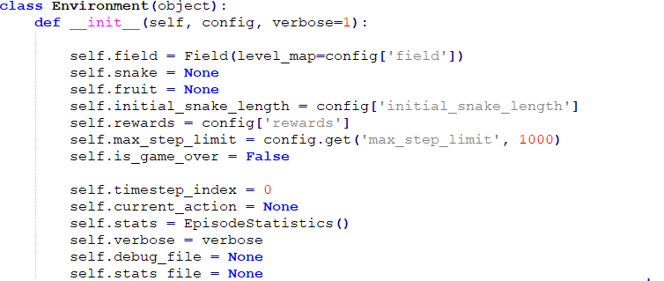
The Environment
Point: Class that represent 2D point with named axes
CellType: Define types of cells like empty, fruit, snake head, snake body, wall etc. that can be found in the game
SnakeDirection: Defines possible directions(i.e. North, South, east or West) the snake can take and the corresponding offsets
SnakeAction: Maintain Direction, turn left or turn right.
Snake: Snake that has a position, can move, and change directions
Field: Playing field for the game

Slide 5
The Agents
DQN Agent
Human Agent
Random Action Agent

Slide 6
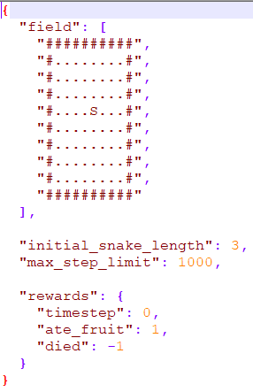
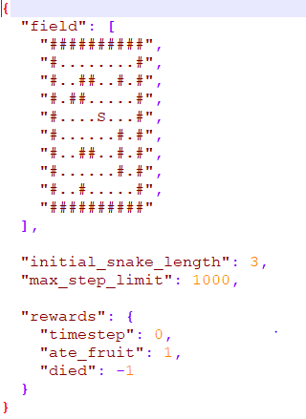
Levels
10x10-blank :
snake can move freely inside a 10x10 block
dies when it hits the wall or when it hits onto itself
starts with initial length of 3 cell.
10x10-obstacle :
snake has to dodge the obstacles inside a 10x10 block
dies when it hits the wall, hits the obstacle or when it hits onto itself
starts with initial length of 3 cell.

Slide 7
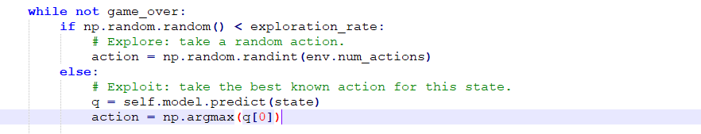
Deep Q Learning
Q-values updated after each episode, rather than each epoch
For a given state s, score R for actions (a1, …, ai,... an) :
R= Q(s|ai)
Exploration vs Exploitation
Notes:
Epoch - full game
Episode - 1 round of playing the game

Slide 8
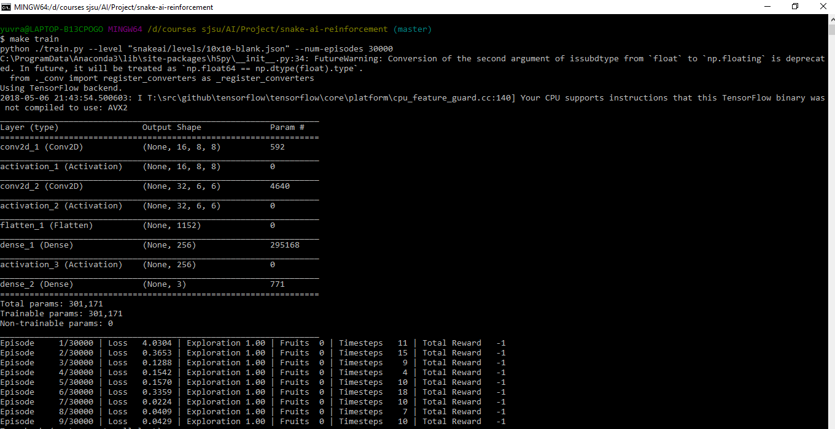
Training the model
Using Q-Learning, model trains from scratch
Episodic tasks
Trained over 30,000 episodes
Training time ~ 25 hours
Conv2d
Activation Model - relu
Notes:
ReLu - function and derivative both are monotonic

Slide 9
Thank you

